Slide 1
Group 3: GAI for Education
Michael Soebroto, Mohnish Sai Prasad, Rithesh Kumar

Slide 2
Problem & Motivation
Problem: There a large amount of course material out there and it is time consuming to go through.
Students often have a very short attention-span for tasks like these which causes inefficient learning.
Goal: Construct a tool that turns a collection of video lectures and reading material into a more consumable format.

Slide 3
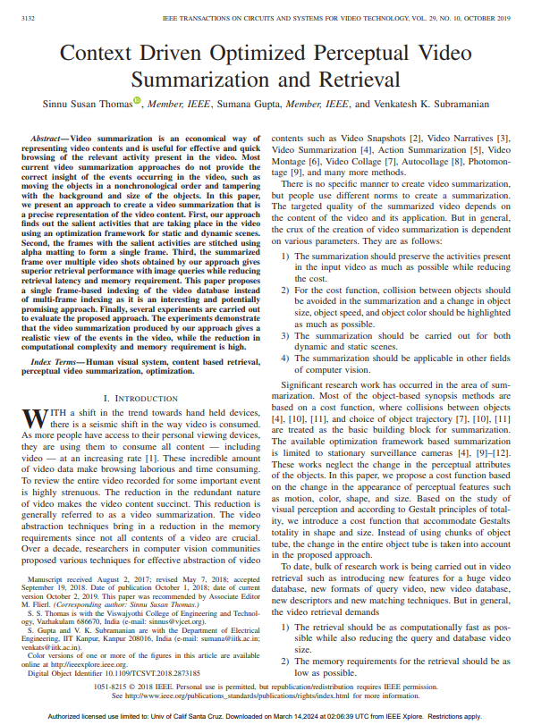
Literature Survey
Two phases:
speech-to-text conversion to generate the transcripts
Extractive Text Summarization to summarize the text generated.
Creates a summary using a single frame at a time. Might not be enough to capture the entirety of a complex concept.
Focus is more on retrieving relevant videos than specifically summarizing the content.

Slide 4
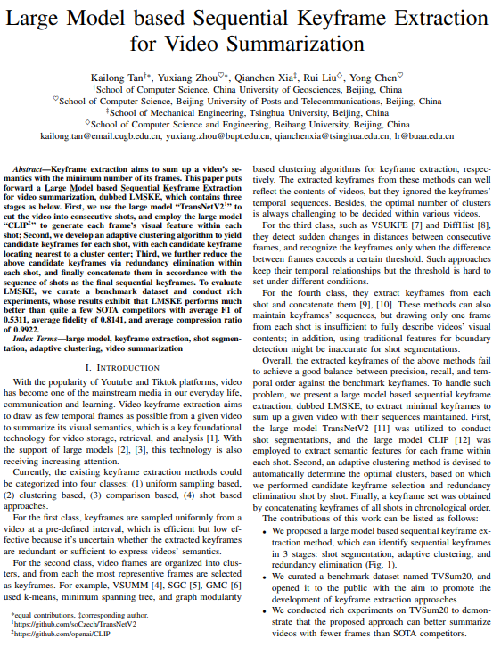
Literature Survey
Collects the keyframes of the video and leverages LLMs to understand the video's visual content and segment it into shots.
Prioritizes capturing the key visual information within each shot.
Not enough stress on narration of the video that are crucial for video lectures.

Slide 5
Approach
By summarizing video transcript and enhancing it with information from associated reading material, we can give a summary of video content that includes additional relevant information for better understanding of the topic.

Slide 6
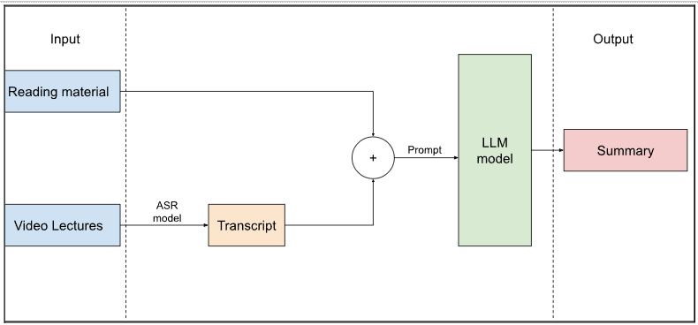
Approach
Initial approach: Summarize both video transcript and reading material separately and then summarize both summaries
Loss of information when summarizing reading material
Approach: Use an LLM to generate a summary of the video transcript given additional reading material and human-generated summary as reference for few shot prompting

Slide 7
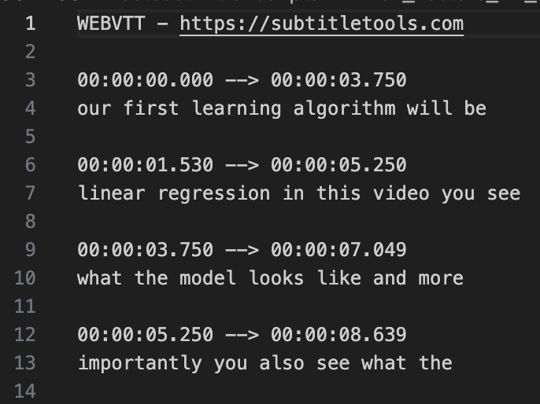
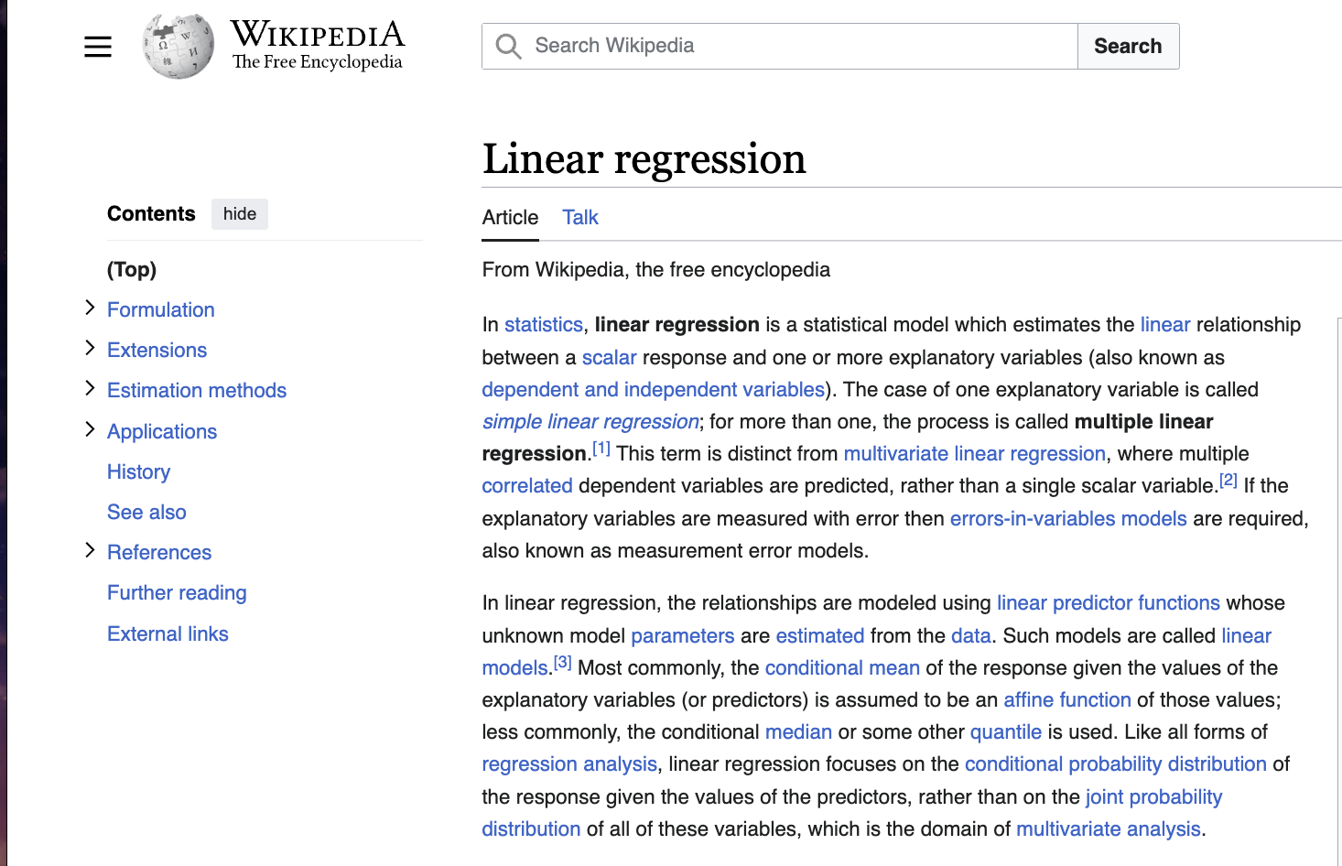
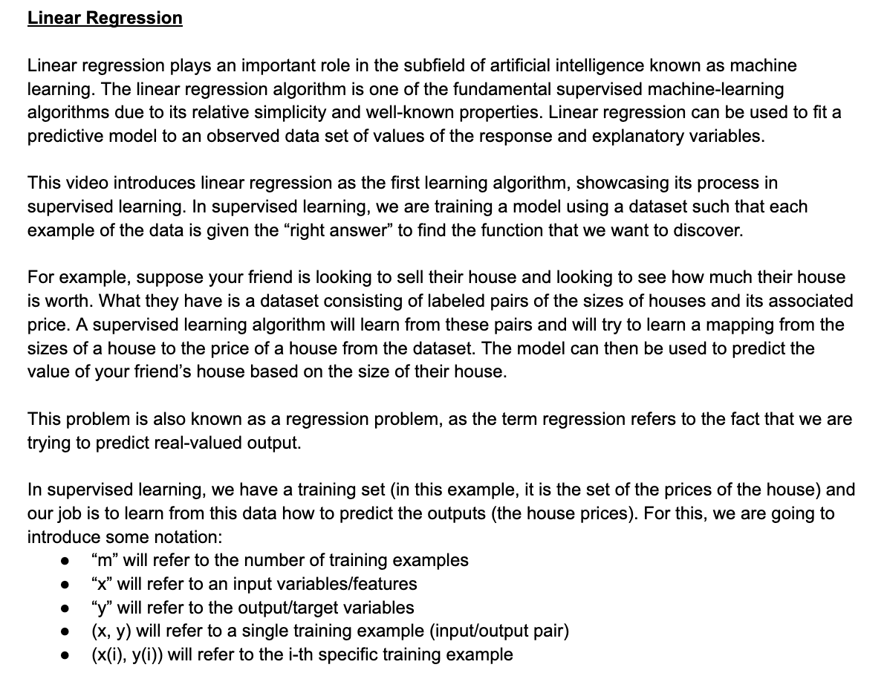
Dataset
Selected videos from EDUVSUM dataset and extract transcript
Used Wikipedia pages for each topic as reading material
Created human-generated summaries on video content and incorporate information from reading content

Slide 8
Implementation
Retrieve the transcript from video
Handpick associated reading material
Generate gold-standard summaries
Tried out various text summarisers to see which works best
GPT 3.5 gave more promising results
Train GPT 3.5 Turbo model using few-shot learning
Input: Video Transcript + Reading Material
Labelled Output: Human-Generated Summary

Slide 9
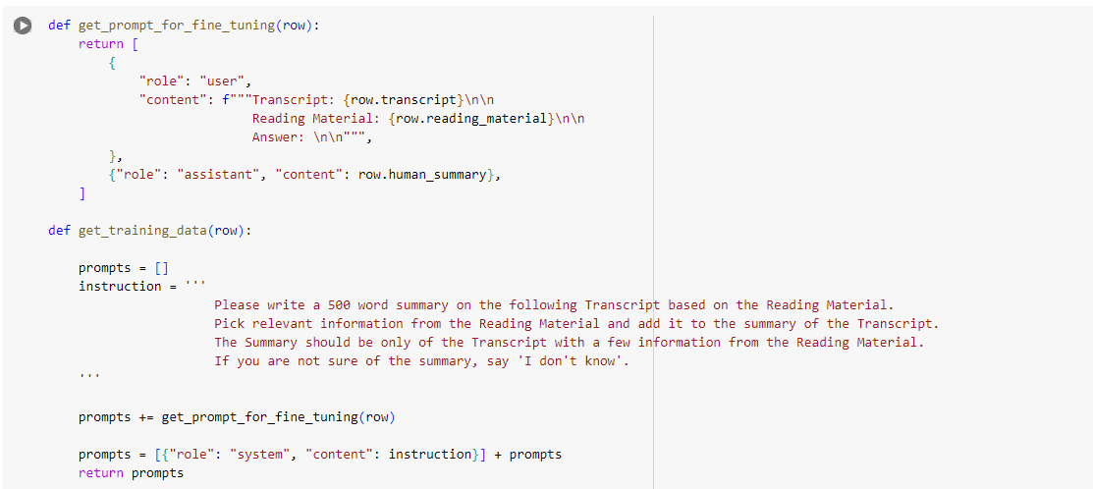
Training - Few-shot learning
Prompt

Slide 10
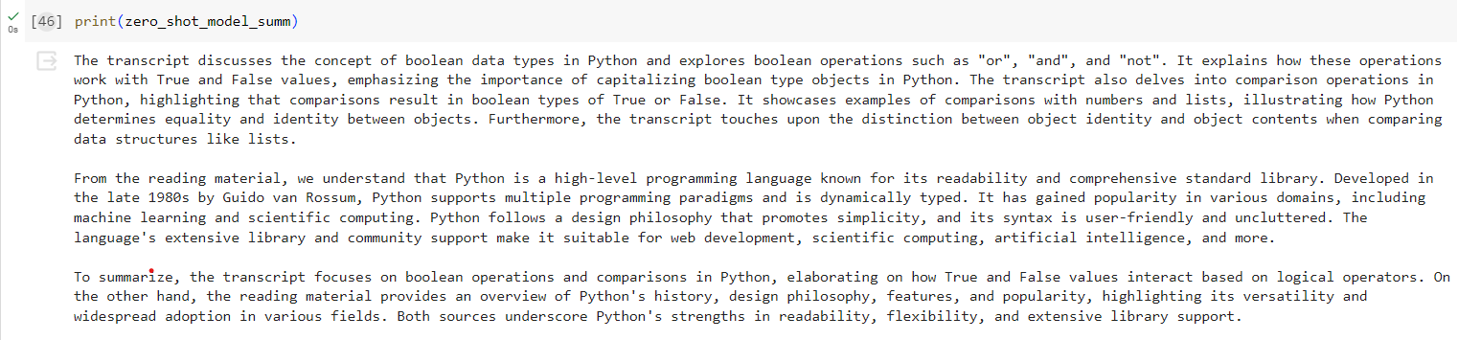
Training - Few-shot learning
Zero-shot trained model

Slide 11
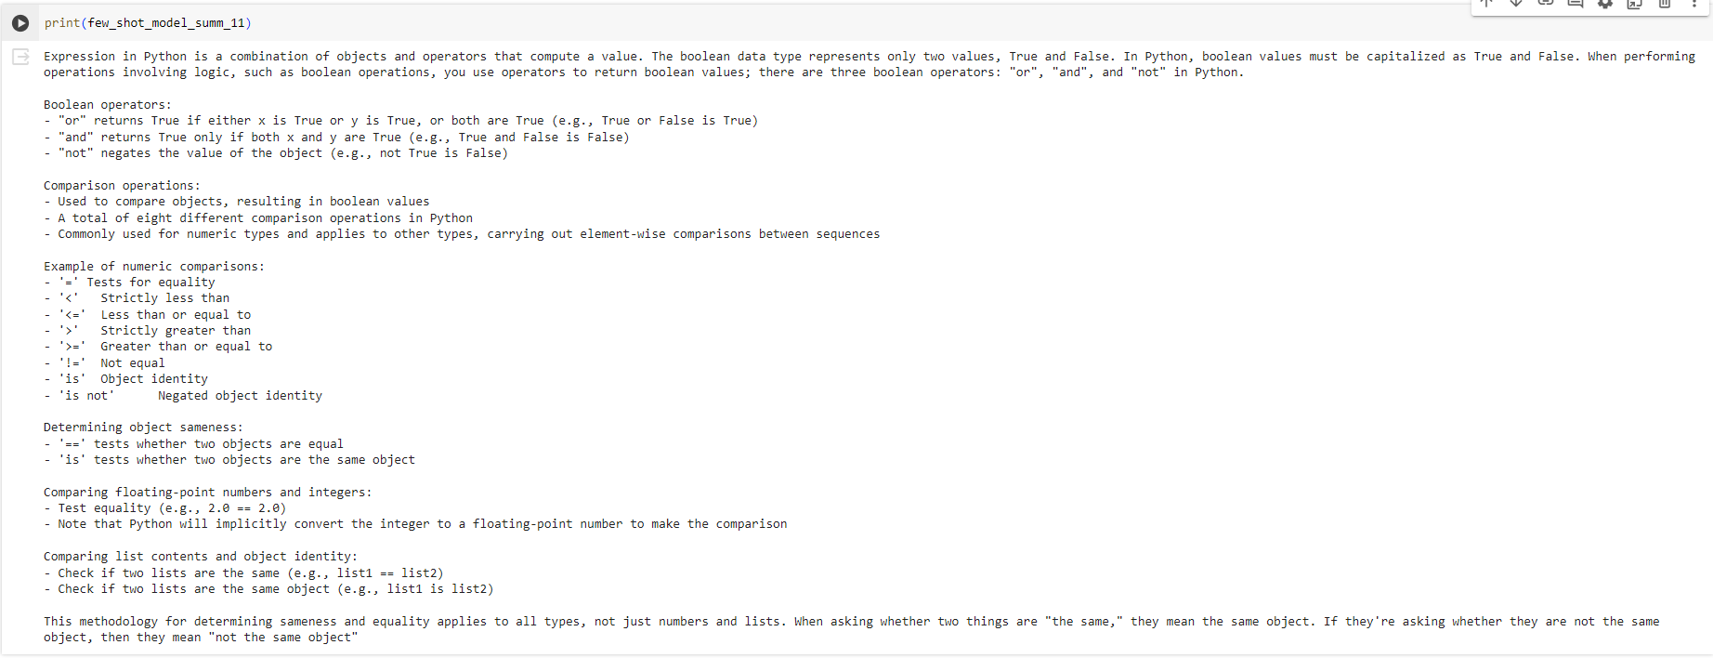
Training - Few-shot learning
Few-shot trained over 11 data points

Slide 12
Evaluation
Created a survey asking participants to evaluate two summaries
Naive Summary (without reading material) of Video Transcript on GPT 3.5
Enhanced Summary (with reading material) using our model
Generated 20 summaries using both models
Evaluated both summaries on a scale of 1-5, based on the quality and how informative each summary is
Also, had a final question which asks for the participant’s preferred summary
Surveys were posted as crowdsourced tasks on Prolific where each task had a reward of $2.5

Slide 13
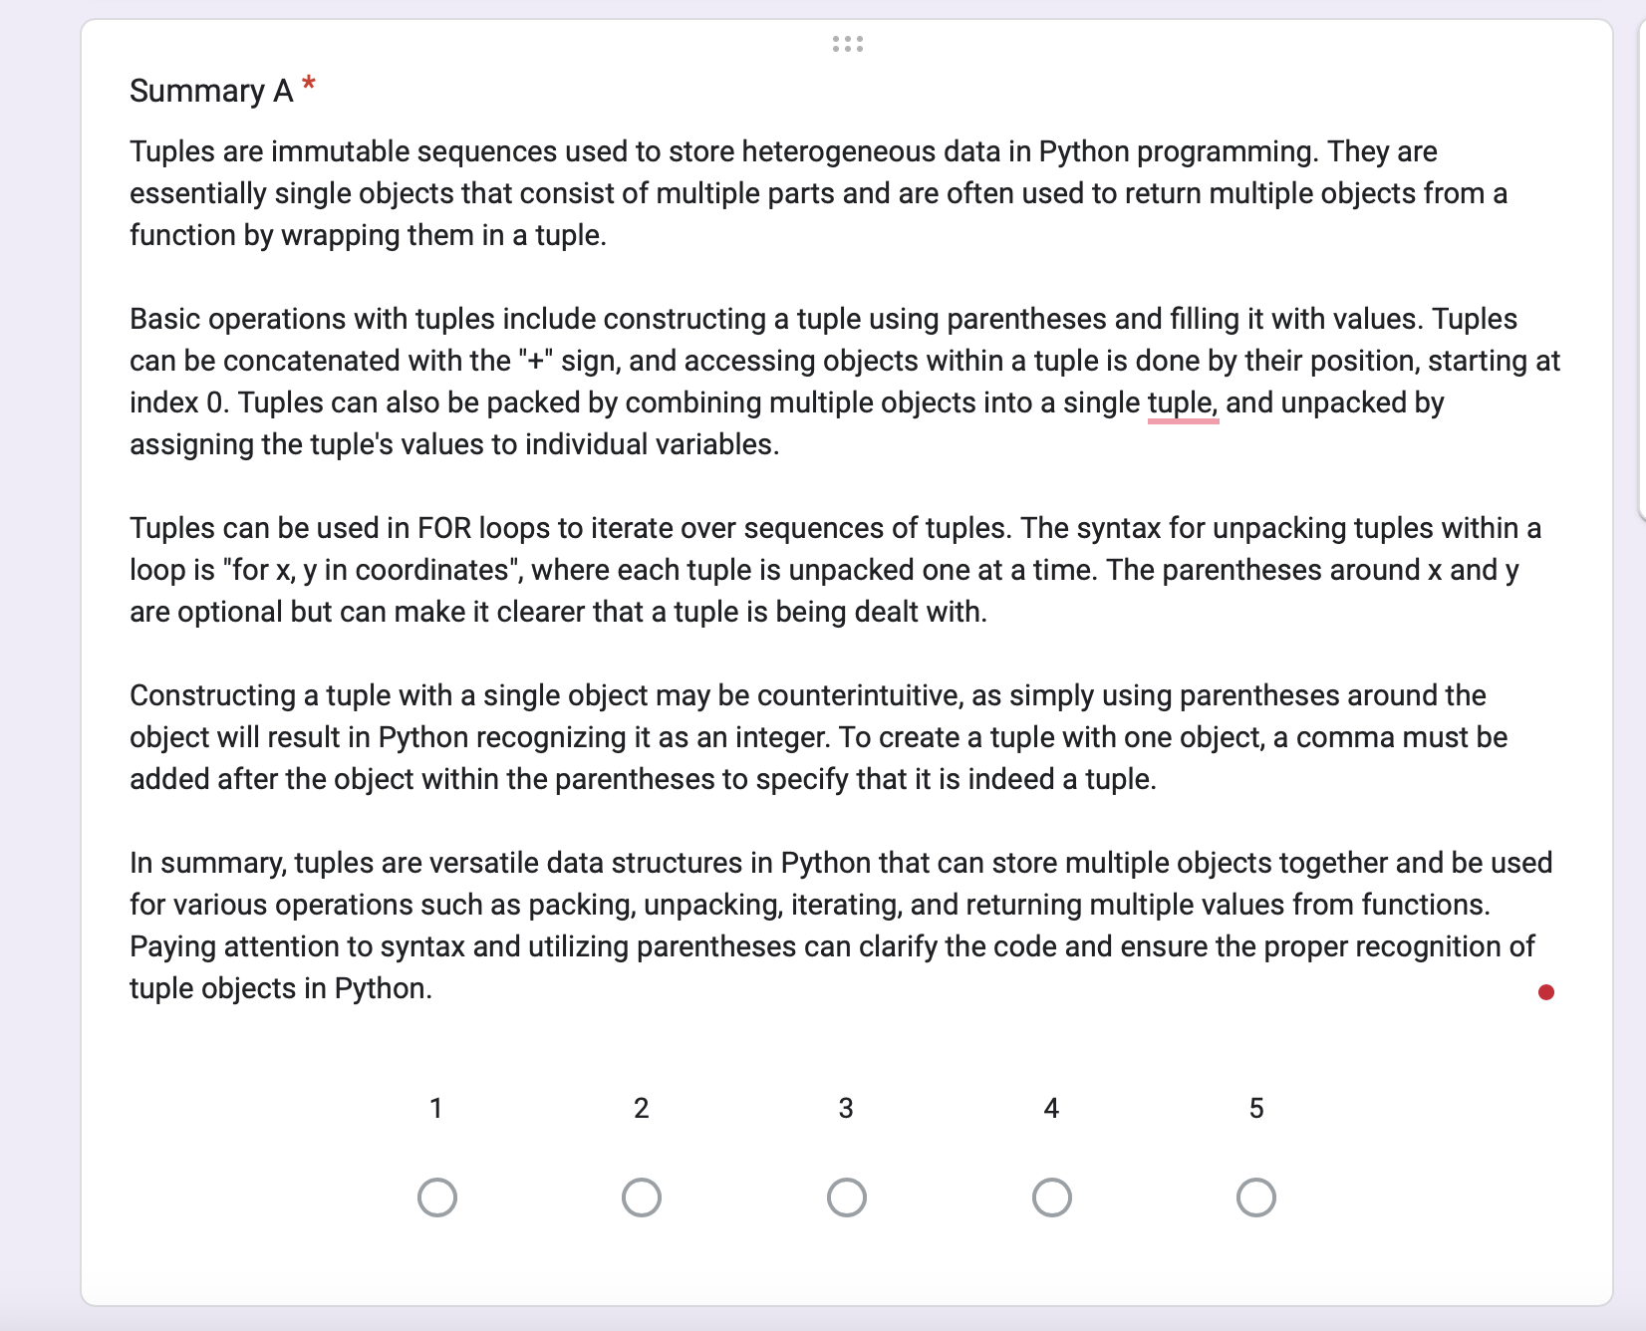
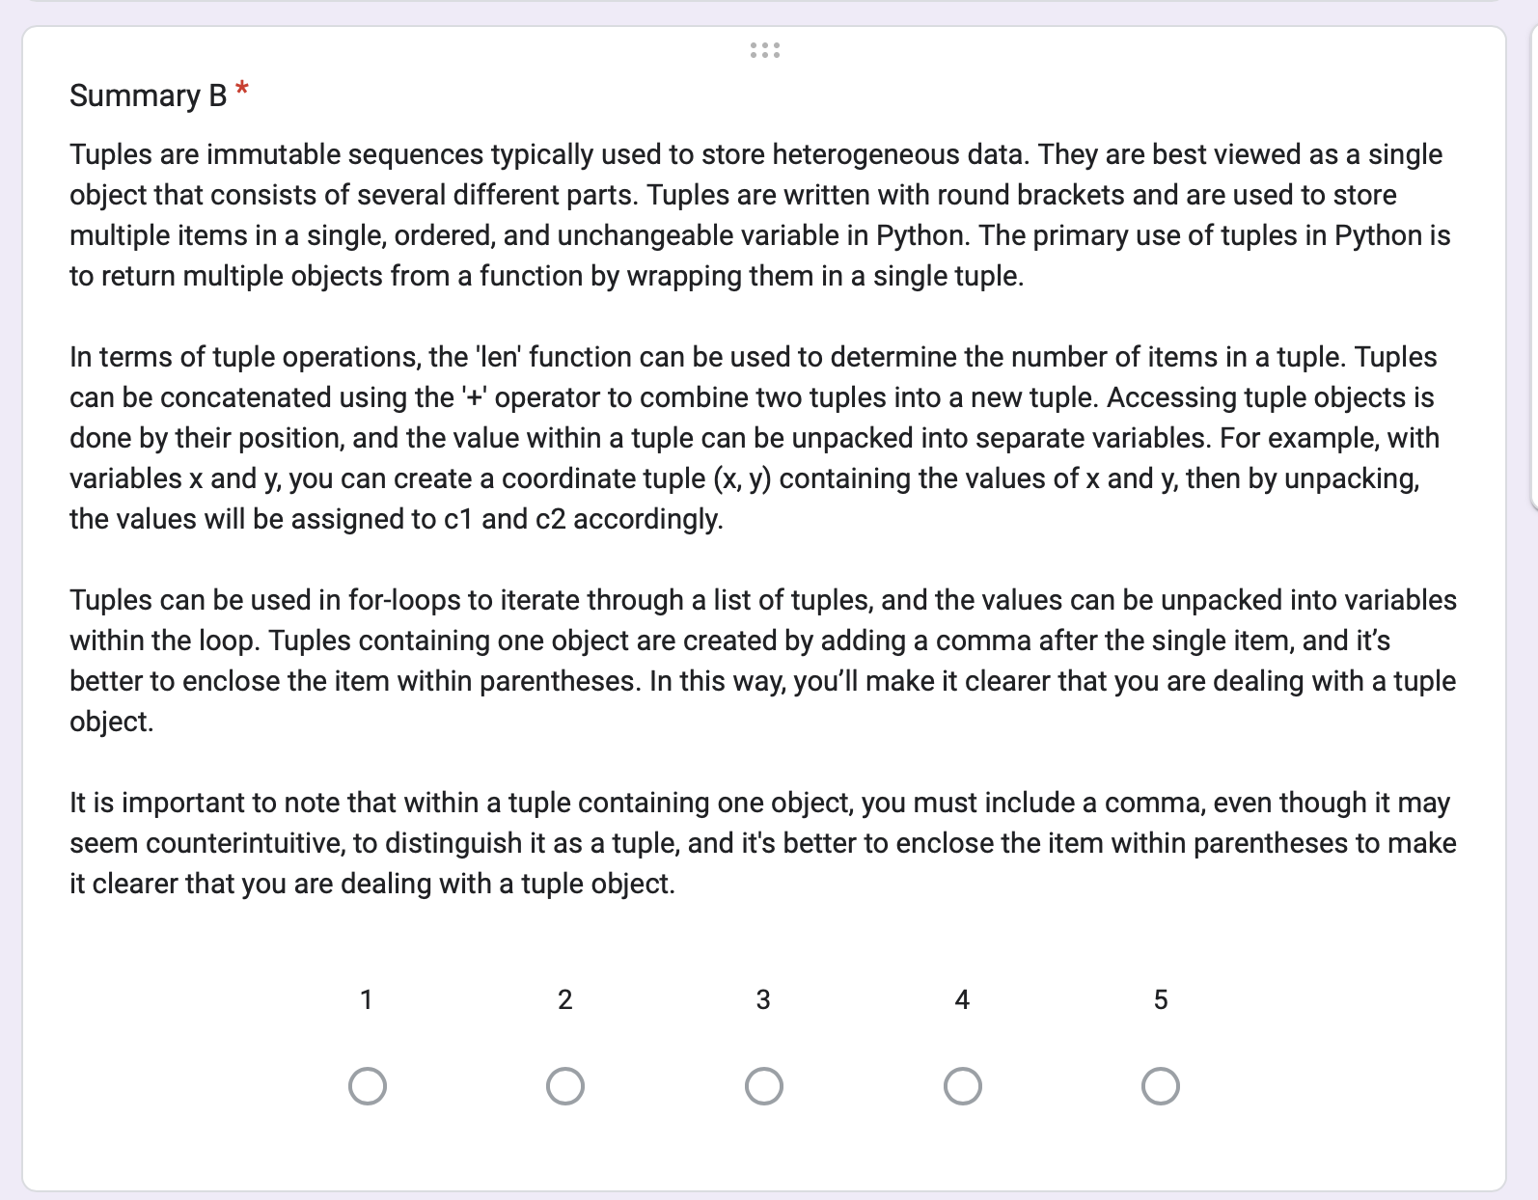
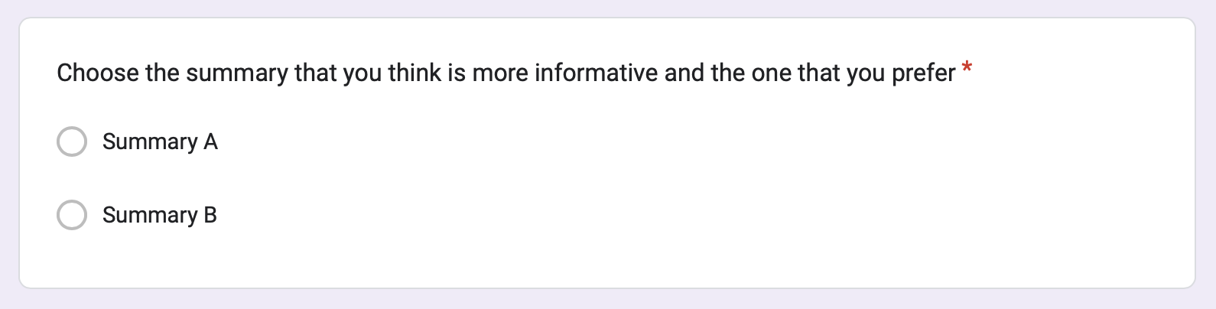
Evaluation

Slide 14
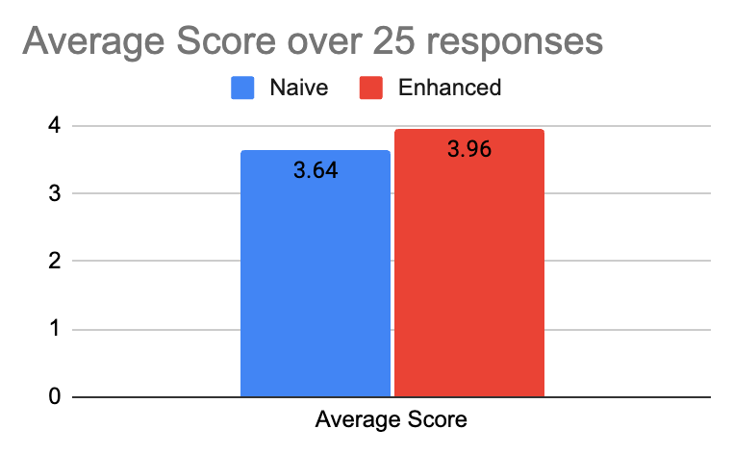
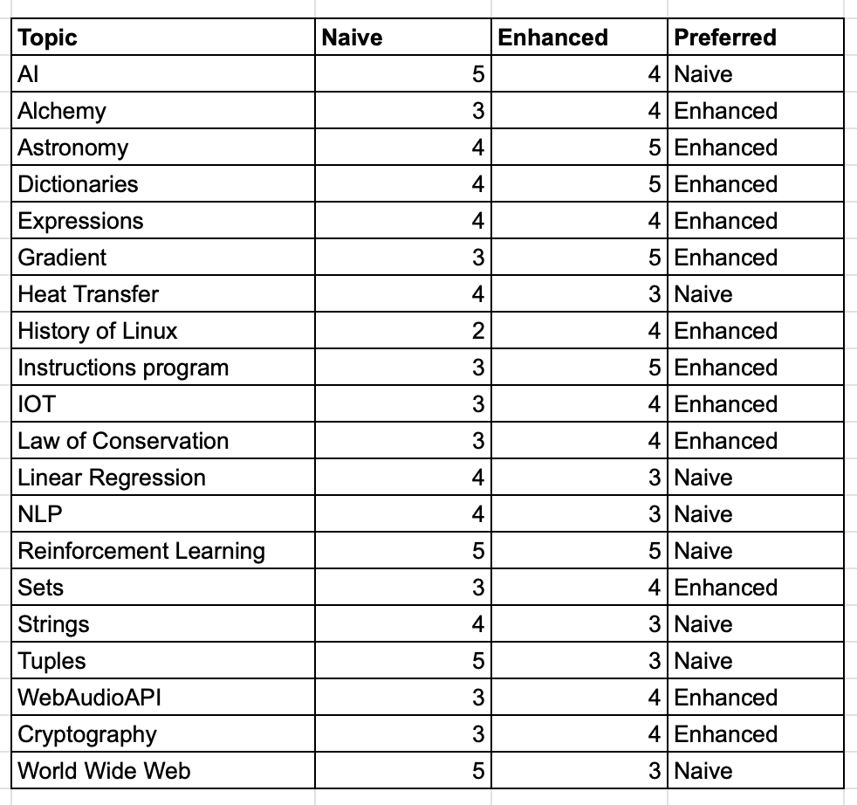
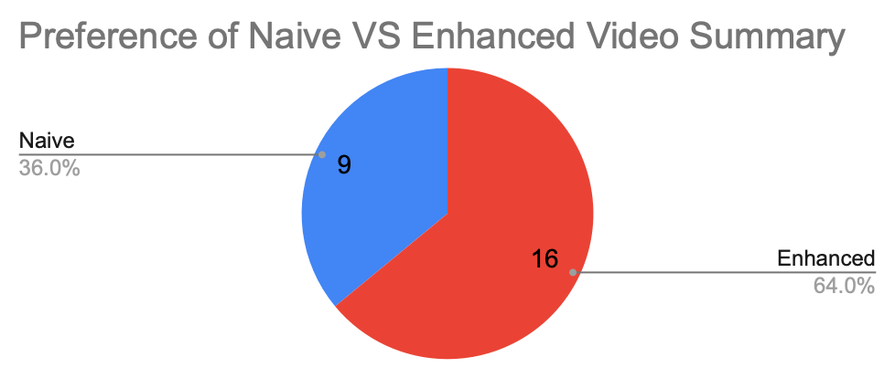
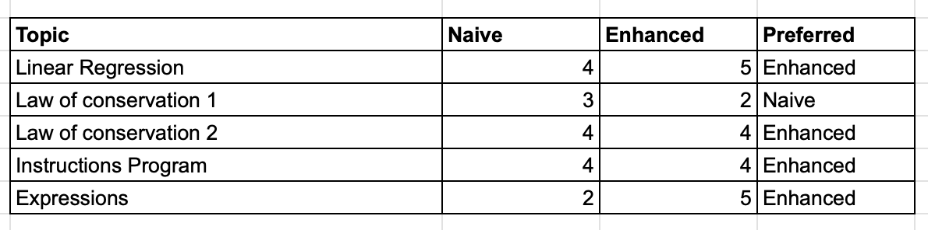
Results

Slide 15
Limitations and Future Work
Limitations:
Lack of a standardised evaluation mechanism
Lack of human-generated summary data for video lectures (let alone video+reading material summary)
Future Work:
Using a dedicated Knowledge Base for storing the reading material
Capture visuals from the video and add to the summary
Add some images to the summary (diagrams, charts, etc)

Slide 16
Conclusion
Idea: Generate summaries for video lecture enriched by relevant reading materials.
Approach: Extracted transcripts from video and combined it with the reading material to feed to LLM for summary generation.
Few-Shot learning of LLM for video summarization shows improved results over the Zero-Shot prompting
Based on a survey, we found that 16 out of 25 people preferred enhanced summaries over the naive summaries

Slide 17
References
Benedetto, Irene, et al. "Abstractive video lecture summarization: applications and future prospects." Education and Information Technologies (2023): 1-21.
Apostolidis, Evlampios, et al. "Video summarization using deep neural networks: A survey." Proceedings of the IEEE 109.11 (2021): 1838-1863.
Mahapatra, Debabrata, et al. "Videoken: Automatic video summarization and course curation to support learning." Companion Proceedings of the The Web Conference 2018. 2018.
Oliveira, Leandro Massetti Ribeiro, et al. "Summarization of Educational Videos with Transformers Networks." Proceedings of the 29th Brazilian Symposium on Multimedia and the Web. 2023.
Kota, Bhargava Urala, et al. "Automated whiteboard lecture video summarization by content region detection and representation." 2020 25th International Conference on Pattern Recognition (ICPR). IEEE, 2021.
Ke, Fangyuan, Pengcheng Li, and Wenlian Lu. "Video Summarization by DiffPointer-GAN." Neural Information Processing: 28th International Conference, ICONIP 2021, Sanur, Bali, Indonesia, December 8–12, 2021, Proceedings, Part VI 28. Springer International Publishing, 2021.
Chau, Hung, et al. "Automatic concept extraction for domain and student modeling in adaptive textbooks." International Journal of Artificial Intelligence in Education 31 (2021): 820-846.
Tyagi, Tirath, et al. "Video Summarization using Speech Recognition and Text Summarization." 2023 4th International Conference for Emerging Technology (INCET). IEEE, 2023.
Sun, Fan, and Xuedong Tian. "Lecture Video Automatic Summarization System Based on DBNet and Kalman Filtering." Mathematical Problems in Engineering 2022 (2022).
Tan, Kailong, et al. "Large Model based Sequential Keyframe Extraction for Video Summarization." arXiv preprint arXiv:2401.04962 (2024).

Slide 18
Thank You! Questions?

